Slide 1
Declutter
Done by: Kenny Barza

Slide 2
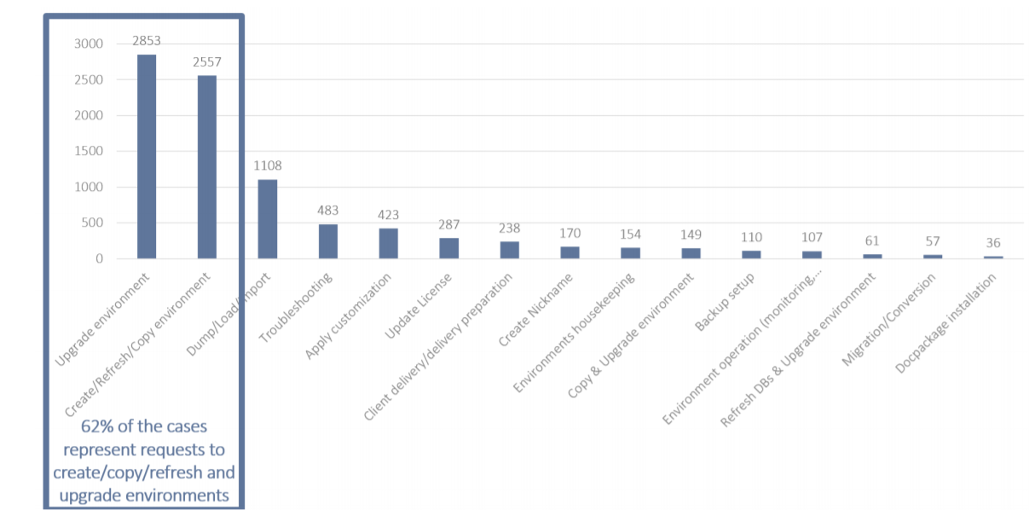
This is the old graph

Slide 3
1) Data-ink Ration Discussion
1) First, this rectangle is taking too much space just to group two categories. It makes the visual a bit messy.
3) y-axis could be removed because we are already labeling each bar.
2) Gridline could be removed which creates whitespace potentially making the visual clearer to the eye

Slide 4
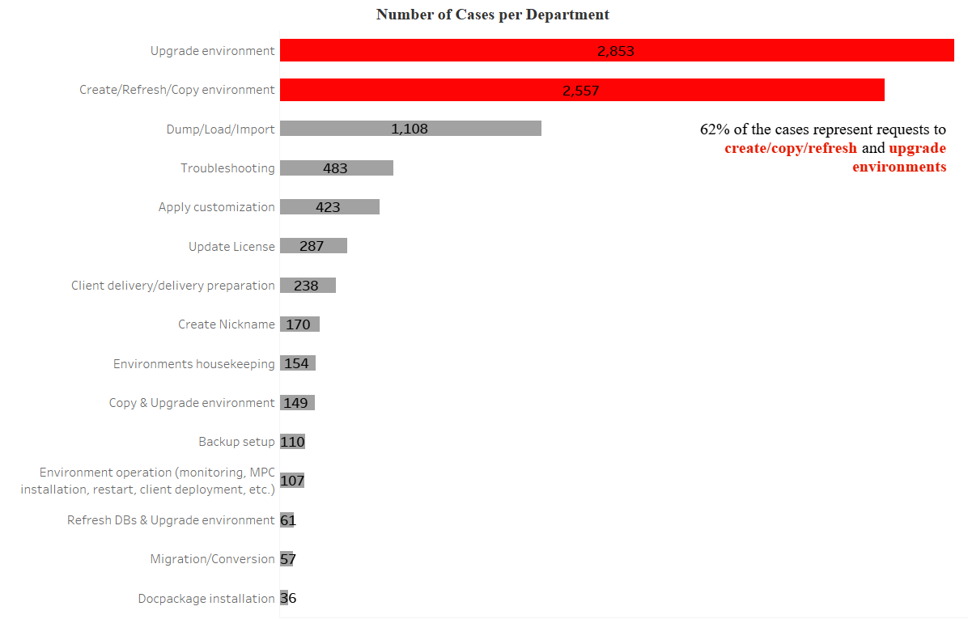
2) Creating my own visualization

Slide 5
3) Highlight of the Different Principles Adopted.
Proximity Principle: We made sure to group the two categories that we want to emphasize together. This is done by putting the categories close together.
Similarity Principle: We changed the color of these two dominant categories and also the bar width so that the audience can immediately notice the difference between these 2 categories and the others. In other words, we created a contrast.

Slide 6
3) Highlight of the Different Principles Adopted.
We made sure to change the color of the text that matches the color of the categories it refers to.
Continuity Principle: we removed the y axis. Our eyes can still see that the bars are lined up.

Slide 7
3) Highlight of the Different Principles Adopted.
We removed the grids to create whitespaces. This is extremely important for our visualization to stand out. We also made sure that each bar is separated from the other by whitespace.

Slide 8
Thank You

